Slide 1
Lecture #14: Local Area Networks
ALOHA
Ethernet
Token Ring
Token Bus

Slide 2
Medium Access Control sublayer
Networks can be divided into two categories:
those using point-to-point connections and those using broadcast channels.
In any broadcast network, the key issue is how to determine who gets to use the channel when there is competition for it.
The protocols used to determine who goes next on a multiaccess channel belong to a sublayer of the data link layer (DLL) called the MAC (Medium Access Control) sublayer. The MAC sublayer is especially important in LANs, many of which use a multiaccess channel as the basis for communication. WANs, in contrast, use point-to-point links, except for satellite networks.
Technically said, the MAC sublayer is the bottom part of the DLL.

Slide 3
The Channel Allocation Problem
How to allocate a single broadcast channel among several competing users!?
Static Channel Allocation in LANs and MANs
Allocating a single channel, such as a telephone trunk, among multiple competing users is Frequency Division Multiplexing (FDM). If there are N users, the bandwidth is divided into N equal-sized portions, each user being assigned one portion. Since each user has a private frequency band, there is no interference between users.
When the number of senders is large and continuously varying or the traffic is bursty, FDM presents some problems. If more than N users want to communicate, some of them will be denied permission for lack of bandwidth.

Slide 4
Dynamic Channel Allocation in LANs and MANs
Assumptions:
Station Model. The model consists of N independent stations (e.g., computers, telephones, or personal communicators), each with a program or user that generates frames for transmission. Stations are sometimes called terminals. The probability of a frame being generated in an interval of length Dt is l*Dt, where l is a constant (the arrival rate of new frames). Once a frame has been generated, the station is blocked and does nothing until the frame has been successfully transmitted.
Single Channel Assumption. A single channel is available for all communication. All stations can transmit on it and all can receive from it. As far as the hardware is concerned, all stations are equivalent, although protocol software may assign priorities to them.

Slide 5
Dynamic Channel Allocation in LANs and MANs (2)
Assumptions:
Collision Assumption. If two frames are transmitted simultaneously, they overlap in time and the resulting signal is garbled. This event is called a collision. All stations can detect collisions. A collided frame must be transmitted again later. There are no errors other than those generated by collisions.
Continuous Time. Frame transmission can begin at any instant. There is no master clock dividing time into discrete intervals.
Slotted Time. Time is divided into discrete intervals (slots). Frame transmissions always begin at the start of a slot. A slot may contain 0 or more frames, corresponding to an idle slot, a successful transmission, or a collision, respectively.

Slide 6
Dynamic Channel Allocation in LANs and MANs (3)
Assumptions:
Carrier Sense. Stations can tell if the channel is in use before trying to use it. If the channel is sensed as busy, no station will attempt to use it until it goes idle.
No Carrier Sense. Stations cannot sense the channel before trying to use it. They just go ahead and transmit. Only later can they determine whether the transmission was successful.

Slide 7
ALOHA
ALOHA - a ground-based radio broadcasting system. Many uncoordinated users are competing for the use of a single shared channel.
In the 1970s, Norman Abramson and his colleagues at the University of Hawaii devised a new and elegant method to solve the channel allocation problem.
Two versions of ALOHA: pure and slotted.
Pure ALOHA does not require global time synchronization; slotted ALOHA does.

Slide 8
Pure ALOHA
The basic idea: Users transmit whenever they have data to be sent.
The Sender can always find out whether its frame was destroyed by listening to the channel, the same way other users do.
With a LAN, the feedback is immediate (almost);
with a satellite, there is a delay of 270 msec before the sender knows if the transmission was successful.
If listening while transmitting is not possible for some reason, acknowledgements are needed.
If the frame was destroyed, the sender just waits a random amount of time and sends it again.

Slide 9
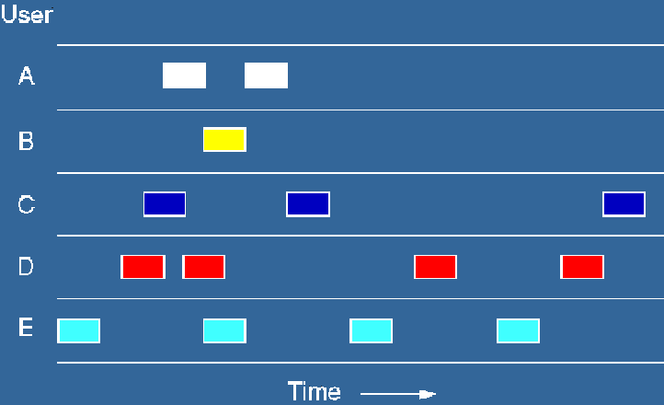
Pure ALOHA (2)
Frames are transmitted at completely arbitrary times.

Slide 10
Pure ALOHA (3)
Whenever two frames try to occupy the channel at the same time, there will be a collision and both will be garbled. Both will have to be retransmitted later.
The checksum cannot (and should not) distinguish between a total loss and a near miss.

Slide 11
Slotted ALOHA
The method: Divide time into discrete intervals, each interval corresponding to one frame.
A special station emits a pip at the start of each interval, like a clock.
A user is not permitted to send whenever a special chcaracter (for example: CR) is typed. Instead, it is required to wait for the beginning of the next slot.

Slide 12
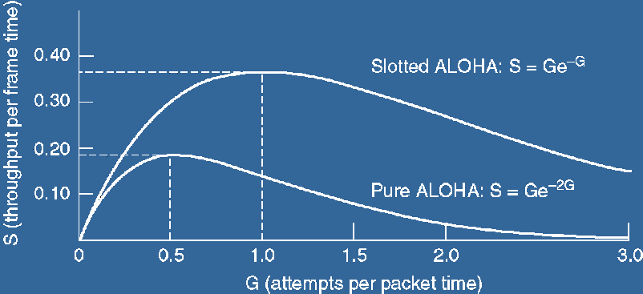
ALOHA systems comparison
Throughput versus offered traffic for ALOHA systems.

Slide 13
Carrier Sense Multiple Access Protocols
With slotted ALOHA the best channel utilization that can be achieved is 1/e. Stations transmitting at will, without paying attention to what the other stations are doing => many collisions.
In LAN, however, it is possible for stations to detect what other stations are doing, and adapt their behavior accordingly => much better utilization than 1/e.

Slide 14
Carrier Sense Multiple Access Protocols (2)
Protocols in which stations listen for a carrier (i.e., a transmission) and act accordingly are called carrier sense protocols.
Many stations can attempt to transmit at a time – multiple access.

Slide 15
CSMA types: persistent and nonpersistent
1-persistent: When a station has data to send, it first listens to the channel to see if anyone else is transmitting at that moment. If the channel is busy, the station waits until it becomes idle. When the station detects an idle channel, it transmits a frame. If a collision occurs, the station waits a random amount of time and starts all over again. The protocol is called 1-persistent because the station transmits with a probability of 1 when it finds the channel idle.

Slide 16
CSMA types: persistent and nonpersistent (2)
Nonpersistent: Before sending, a station senses the channel. If no one else is sending, the station begins doing so itself. However, if the channel is already in use, the station waits a random period of time and then repeats the algorithm. Consequently, this algorithm leads to better channel utilization but longer delays than 1-persistent CSMA.

Slide 17
CSMA types: persistent and nonpersistent (3)
p-persistent: It applies to slotted channels. When a station is to send, it senses the channel. If it is idle, it transmits with a probability p. With a probability
q = 1 - p, it defers until the next slot. If that slot is also idle, it either transmits or defers again, with probabilities p and q. This process is repeated until either the frame has been transmitted or another station has begun transmitting.
In the latter case, the unlucky station acts as if there had been a collision (i.e., it waits a random time and starts again).
If the station initially senses the channel busy, it waits until the next slot and applies the above algorithm.

Slide 18
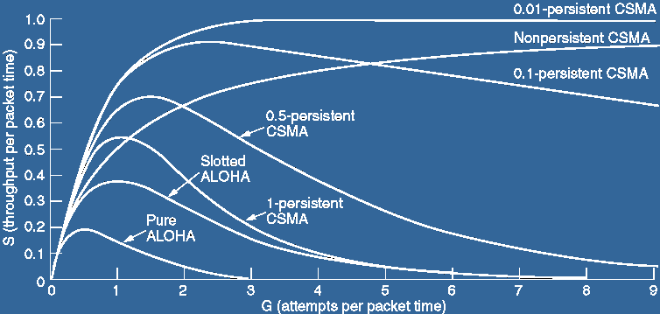
CSMA types: persistent and nonpersistent (4)
Comparison of the channel utilization versus load for various random access protocols.

Slide 19
CSMA with Collision Detection
(CSMA / CD)
Rather than finish transmitting their frames, which are irretrievably garbled anyway, the stations should abruptly stop transmitting as soon as the collision is detected. Quickly terminating damaged frames saves time and bandwidth.
This protocol, is the basis of the popular Ethernet LAN.

Slide 20
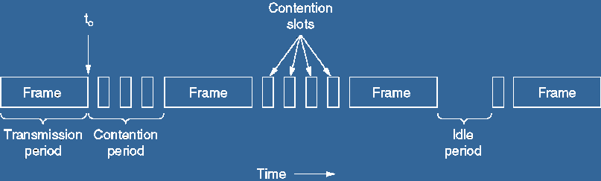
CSMA / CD states
contention, transmission, or idle

Slide 21
CSMA / CD details
After a station detects a collision, it aborts its transmission, waits a random period of time, and then tries again, assuming that no other station has started transmitting in the meantime. The CSMA/CD model will consist of alternating contention and transmission periods, with idle periods occurring when all stations are quiet.
Suppose that two stations both begin transmitting at exactly time t₀. The minimum time to detect the collision is then just the time it takes the signal to propagate from one station to the other.

Slide 22
CSMA / CD details (2)
The collision detection is an analog process! The station's hardware must listen to the cable while it is transmitting and the signal encoding must allow collisions to be detected (e.g., a collision of two 0-volt signals may be impossible to detect). For this reason, special encoding is commonly used.
The sending station must continually monitor the channel, listening for noise bursts that might indicate a collision. For this reason, CSMA/CD with a single channel is inherently
a half-duplex system. It is impossible for a station to transmit and receive frames at the same time because the receiving logic is in use, looking for collisions during every transmission.
No MAC-sublayer protocol guarantees reliable delivery. Even in the absence of collisions, the receiver may not have copied the frame correctly for various reasons (e.g., lack of buffer space or a missed interrupt).

Slide 23
Collision-Free Protocols
The collisions affect the system performance, especially when the cable is long and the frames are short. And CSMA/CD is not universally applicable.
Some protocols resolve the contention for the channel without any collisions at all. Most of these are not currently used in major systems, but in a rapidly changing field, having some protocols with excellent properties available for future systems is often a good thing.
Assumptions:
Tthere are exactly N stations, each with a unique address from 0 to N - 1 '‘hardcoded' into it.
It does not matter that some stations may be inactive part of the time.
The propagation delay is negligible.

Slide 24
Bit-Map Protocol
Each contention period consists of exactly N slots.
If station 0 has a frame to send, it transmits a 1 bit during the zeroth slot. No other station is allowed to transmit during this slot.
Regardless of what station 0 does, station 1 gets the opportunity to transmit a 1 during slot 1, but only if it has a frame queued.
In general, station j may announce that it has a frame to send by inserting a 1 bit into slot j.
After all N slots have passed by, each station has complete knowledge of which stations wish to transmit. At that point, they begin transmitting in numerical order.

Slide 25
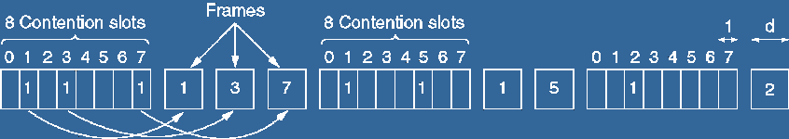
The basic bit-map protocol
Since everyone agrees on who goes next, there will never be any collisions.

Slide 26
Other MA protocol types
Limited-Contention
  Adaptive Tree Walk
Wavelength Division Multiple Access
Wireless LAN Protocols
  MACA (Multiple Access with Collision Avoidance)
  MACAW (MACA for Wireless).

Slide 27
Ethernet
IEEE has standardized a number of LANs and MANs under the name of IEEE 802. A few have survived but many have not.
The most important of the survivors are 802.3 (Ethernet) and 802.11 (wireless LAN)
For 802.15 (Bluetooth) and 802.16 (wireless MAN), it is too early to tell.
Both 802.3 and 802.11 have different physical layers and different MAC sublayers but converge on the same logical link control sublayer (defined in 802.2), so they have the same interface to the network layer.

Slide 28
Ethernet Cabling
Name | Cable | Max seg. (m) | Nodes per segment | Advantages
10Base5 | thick coax | 500 | 100 | The Original
10Base2 | thin coax | 185 | 30 | no hub
10Base-T | twisted pair (UTP) | 100 | 1024 | cheapest
10Base-F | fiber | 2000 | 1024 | long distance

Slide 29
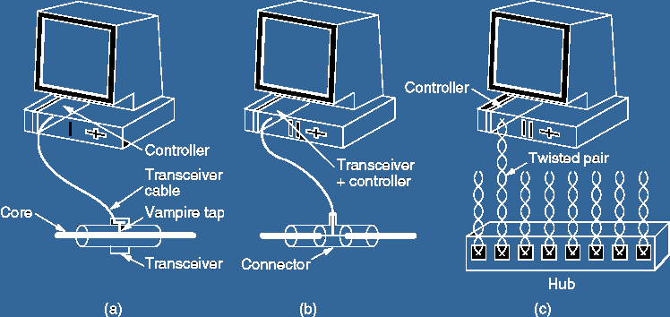
Three kinds of Ethernet cabling
10Base5 10Base2 10Base-T

Slide 30
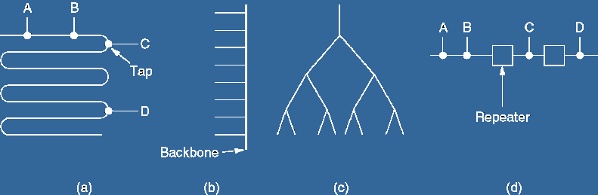
Cable topologies
Linear Spine (bus) Tree Segmented

Slide 31
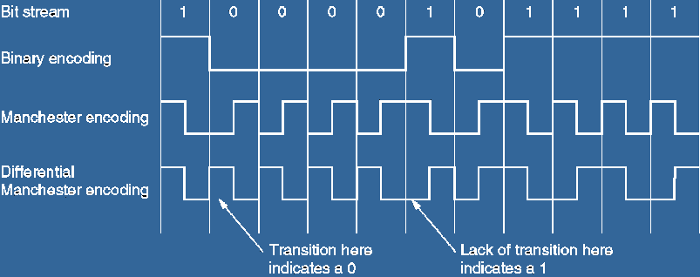
Manchester encoding

Slide 32
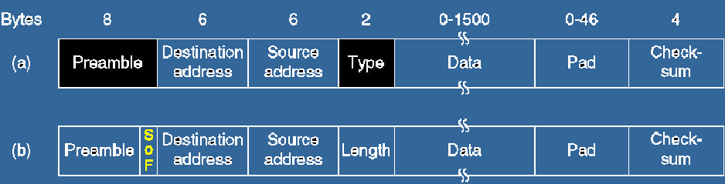
Ethernet frame formats
DIX (DEC, Intel, Xerox)
IEEE 802.3

Slide 33
Ethernet frame format
Preamble: Sequence of 10101010s. 8 bytes.
  (SOF, Start of Frame delimiter, for compatibility with 802.4 and 802.5)
Addresses: 2 or 6 bytes.
    high-order bit of the destination address:
      0 for ordinary addresses
      1 for group addresses.
    bit 46 - global or local address.
  Type: specifies which process to give the frame to.
  (Any number <=1500 is treated as length or as type otherwise.)
Data: up to 1500 bytes.
Pad: (optional) The frame must be at least 64 bytes in total!
Checksum: CRC based on this polynomial:
x³²+x²⁶+x²³+x²²+x¹⁶+x¹²+x¹¹+x¹⁰+x⁸+x⁷+x⁵+x⁴+x²+x+1

Slide 34
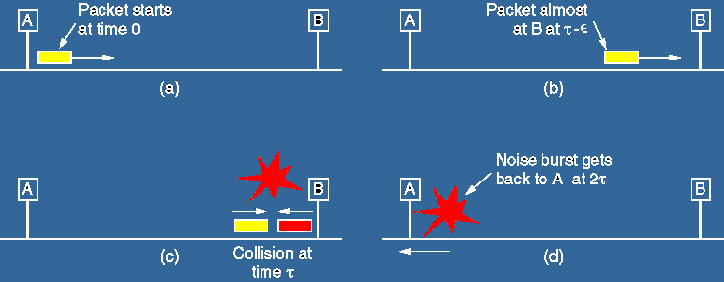
Collision detection

Slide 35
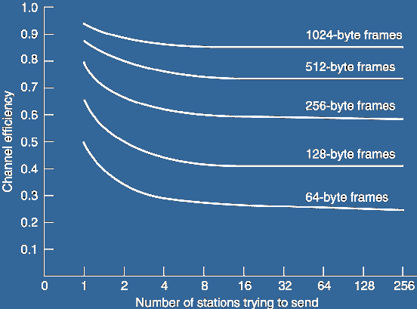
Ethernet Performance
at 10 Mbps with 512-bit slot times.

Slide 36
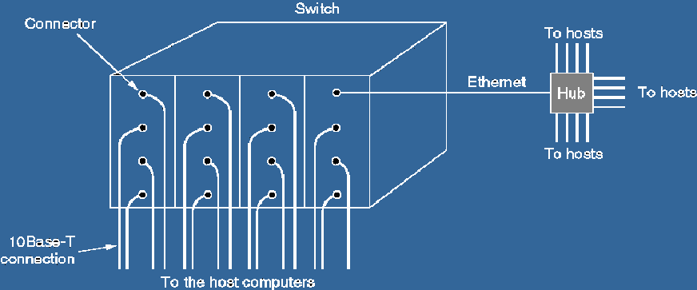
Switched Ethernet

Slide 37
Token Ring – IEEE 802.5
A ring toplogy network developed in the late 1960s. Supported mainly by IBM.
Pushed into the background by Ethernet in the 1990s.
a LAN protocol which resides at the data link layer (DLL) of the OSI model.

Slide 38
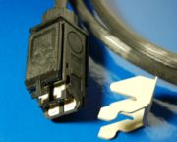
Cabling and speed
Shielded Twisted Pair with unique hermaphroditic connectors (IBM “Type 1”)
or
Symmetric pair.
Speed:
  4 Mbps (1985)
  16 Mpbs (1989, IBM)

Slide 39
Token Ring frame formats
Data or command frame
SD | AC | FC | DA | SA | PDU from LLC (IEEE 802.2) | CRC | ED | FS
8 bits | 8 bits | 8 bits | 48 bits | 48 bits | up to 18200x8 bits | 32 bits | 8 bits | 8 bits
Token
Abort frame
SD | AC | ED
8 bits | 8 bits | 8 bits
SD | ED
8 bits | 8 bits
SD: Starting delimiter
AC: Access control
FC: Frame control
DA: Destination address
SA: Source address
PDU: data
CRC: check sum
ED: End delimiter
FS: Frame status

Slide 40
Token Ring operation
When nobody is transmitting a token circles.
When a station needs to transmit data, it converts the token into a data frame.
When the sender receives its own data frame, it converts the frame back into a token.
If an error occurs and no token frame, or more than one, is present, a special station (“Active Monitor”) detects the problem and removes and/or reinserts tokens as necessary.
The Abort frame: used to abort transmission by the sending station.

Slide 41
Active and Standby monitors
Every station in a token ring network is either an Active monitor (AM) or Standby monitor (SM) station. There can be only one active monitor on a ring at a time. The active monitor is chosen through an election or monitor contention process.
The monitor contention process is initiated when
  A loss of signal on the ring is detected,
  An AM station is not detected by other stations, or
  When a timer on an end station expires (the station hasn't seen a token in the past 7 seconds).
When any of the above conditions take place and a station decides that a new AM is needed.
The AM performs a number of ring management functions and roles:
  Master clock for the ring, synchronization.
  Inserts a 24-bit delay into the ring for sufficient buffering.
  To support exactly one token and there is no frame being transmitted.
  Detects a broken ring.
  Removes circulating frames from the ring.

Slide 42
Token Bus – IEEE 802.4
A network which implements the modified Token Ring protocol over a "virtual ring" on a coaxial cable with a bus topology.
It is mainly used for industrial applications (GM®).
1
1
1
1
1

